Slide 1
FreeSWITCH Monitoring
ClueCon, August 2016
Moisés Silva <moy@sangoma.com>
Manager, Software Engineering

Slide 2
We’re Hiring
Linux developers C/C++ or Python
Anywhere in the world, paid relocation to Toronto or full time remote opportunities
Fun and relaxed work environment

Slide 3
Agenda
Monitoring Basics
Metrics and Logs
Alerting
Traditional Solutions
Emerging Solutions
Afterword (FreeSWITCH Oxidized)

Slide 4
Monitoring Basics
Monitoring is about knowing what is happening on your systems. The good and the bad
Monitoring helps you with prediction/forecasting. Plan your future growth and anticipate problems
Monitoring provides you with the data you need to troubleshoot problems faster

Slide 5
Types of Monitoring
Application Metric Monitoring
Numbers about application usage & performance
You can then use those numbers to define alerts
Service Status Monitoring
Simple binary checks. It’s the service up or not

Slide 6
Monitoring Models
Push vs Pull systems
Push: Graphite, StatsD, CollectD, SNMP
Pull: Prometheus, SNMP
Determines who initiates the metric transfer
Push systems are more dynamic and tend to require less maintenance
Pull systems require a source of truth and node discovery
Pulling however allows you to more effectively detect if a node or application is down

Slide 7
Push Monitoring
Node 1
Monitoring
Server
Metrics and
Check Results
Node 2
Node 3

Slide 8
Pull Monitoring
Node 1
Monitoring
Server
Metric and
Check Requests
Node 2
Node 3

Slide 9
Metrics
Time series data. Sequence of numerical data points listed in time order, usually sampled at regular intervals.
Different granularities of data stored and aggregated over time on fixed-size storage
Time series analysis over the data results in fancy graphs
Example databases: RRDTool, Graphite (Whisper), InfluxDB, Prometheus
Notes:
Mention IoT as a driver for more time series data generation

Slide 10
FreeSWITCH Metrics
Active Calls
Total Calls
Failed Calls
Registrations
Failed Registrations

Slide 11
FreeSWITCH Metrics
ASR (Answer / Seizure Ratio)
NER (Network Effectiveness Ratio)
ACD (Average Call Duration)
PDD (Post Dial Delay)

Slide 12
Logs
Logs can be a source of metrics when metrics and service checks are not enough
You may want to send alerts based on log patterns and repeated log errors
ELK Stack
Elastic Search
Logstash
Kabana

Slide 13
Alerting
Email, Chat (Slack/HipChat), SMS, etc
Alert based on expected metrics and check failures
Procure to use percentiles instead of averages
Several alternatives: Prometheus, Alerta, Flapjack

Slide 14
Alert Fatigue
This happens when alerts are triggered too often and causes the receiver to be desensitized

Slide 15
Alert Fatigue
You know you have it when you start ignoring alerts
Ignoring alerts leads to missing real problems or taking too long to respond to them

Slide 16
Alert Fatigue
Warnings might be well intended and in isolation work well, however, when they add up, they may cause more harm than good
Adjust your thresholds. Be cautious with warning vs critical severity and adjust your notifications accordingly
Kill or fix alerts that are firing too often. You need a way to easily mute them in the meantime

Slide 17
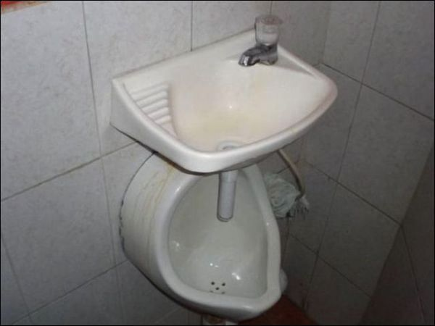
Traditional Solutions
They’re all about getting the job done. And they do:
But at some point you gotta ask yourself if there’s a better way ...

Slide 18
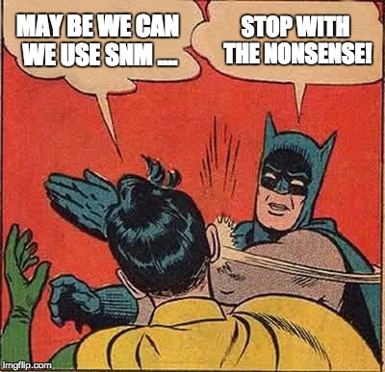
SNMP

Slide 19
SNMP
MIBs/OIDs are cumbersome to use (to say the least)
OIDs available in FreeSWITCH give you number of sessions, active calls, sessions per second etc.
Not easy to collect custom metrics
Very limited information exposed by mod_snmp and overall seems kind of abandoned
The monitoring/management interface in FreeSWITCH needs some work

Slide 20
CACTI & RRDtool
Web front end for the RRDtool time-series database
Collect metrics from multiple sources (e.g snmp)
No one can ever remember how to add a server (convoluted process)

Slide 21
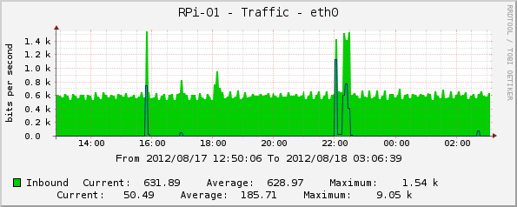
CACTI & RRDtool
You end up with ugly graphs like this:
It’s better than nothing though ….

Slide 22
Monitoring Sucks
So much that around 2011 a “Monitoring Sucks” community was set to fix it:
https://github.com/monitoringsucks
https://github.com/monitoringsucks/blog-posts
https://vimeo.com/monitorama

Slide 23
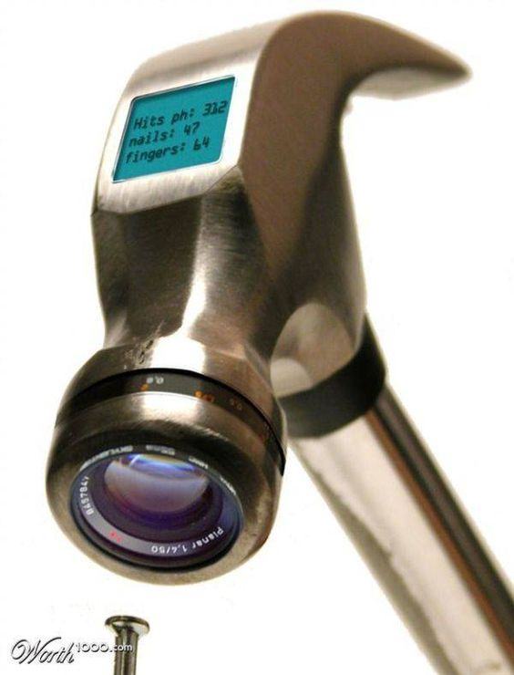
New Solutions
Because new is always better …

Slide 24
Sensu
Monitoring that doesn’t suck (their motto)
You can reuse nagios/zabbix checks. Sensu was designed as a replacement for aging Nagios installations
No time-series database included, you have several options available (e.g Graphite, InfluxDB)

Slide 25
Sensu
Pull/Push system with an agent
Pub/Sub model with pluggable transports (RabbitMQ, Redis, Amazon SQS)
Nodes subscribe to groups of checks. The checks are scheduled by the server or the node.
Both service and metric checks supported
Check results can be sent asynchronously by external jobs via raw TCP + JSON (support in a github PR for HTTP)

Slide 26
Sensu
HTTP API to read access nodes, checks, silence alarms, etc
Nice and simple dashboard UI
Dynamic infrastructure. Servers add themselves to the monitoring system.
Composable json configuration for easy automation (e.g Ansible, SaltStack, Chef etc)

Slide 27
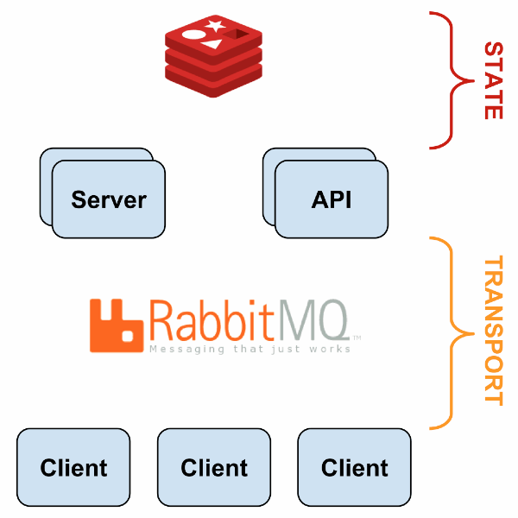
Sensu
Source: sensuapp.org

Slide 28
Graphite
Time-series storage system
Whisper database format designed as an improvement over RRDtool to manage out of time data points
Carbon-cache is a daemon listening for metrics on a TCP socket (typically used in tandem with StatsD)
Metrics are stored in fixed-size files
Comes with a (quite outdated) UI for metric graphs. This is most often used as an http endpoint by other graphing tools like Grafana

Slide 29
Graphite
Every time series is identified by a hierarchy of dot-separated identifiers (e.g stats.freeswitch.total_calls)
The text format to send stats to graphite is dead simple: <metric name> <value> <timestamp>
stats.freeswitch.total_calls 50 1470843323
No further dimensions can be encoded. The typical work-around is to encode them in the metric name:
stats.freeswitch.profile.internal.total_calls 20 1470843323

Slide 30
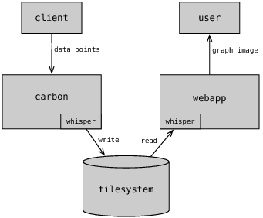
Graphite
Source: http://www.aosabook.org/en/graphite.html

Slide 31
Prometheus
New time-series monitoring system with built-in alerting
Includes its own time-series database format
Multi-dimensional data model (fancy term for key/value pairs labels attached to the time-series metrics)
HTTP-based pull model (Prometheus scraps nodes for metrics via HTTP)
Push gateways supported for applications without a native HTTP endpoint

Slide 32
Prometheus
Client libraries available for many languages so you can instrument your applications
Flexible query language (think SQL for for time-series)
Command line querying tool
Built-in alerting
Can be federated for aggregation of data in multiple data centers

Slide 33
Prometheus
Go standalone application (no dependencies)
All metrics stored, no loss of granularity
Similar format to graphite, with the added dimensions:
freeswitch_total_calls{profile=internal} 20 1470843323

Slide 34
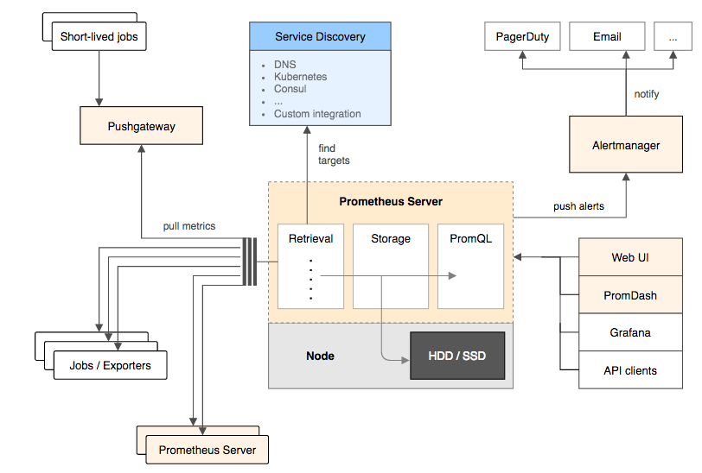
Prometheus

Slide 35
Graphing with Grafana
Powerful dashboard builder application
Support for many backend databases (Prometheus, Graphite)
Automate creation of dashboards with their HTTP API and JSON dashboard definition format
Rich graphing customizations, styling, access control, etc

Slide 36
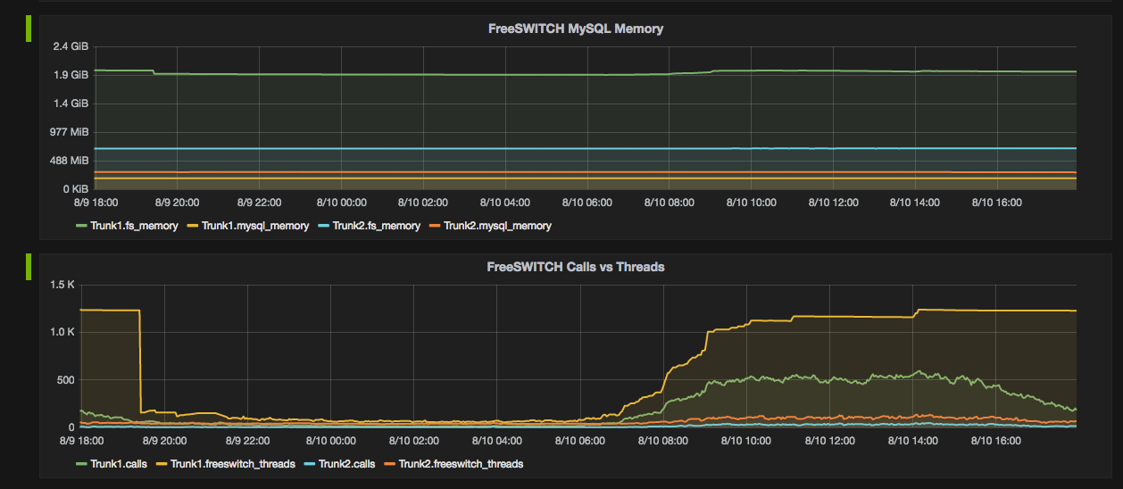
Graphing with Grafana

Slide 37
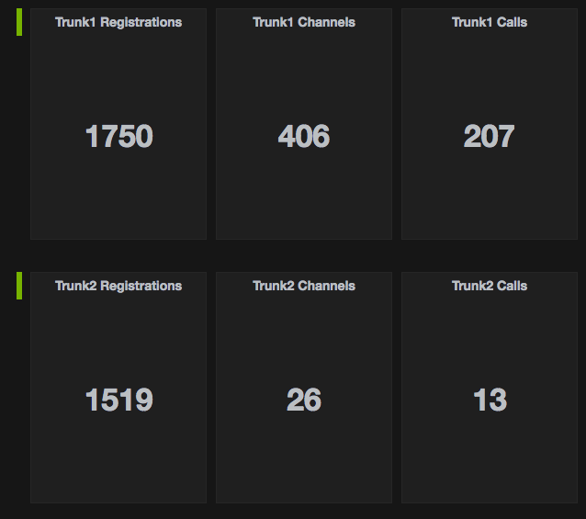
Graphing with Grafana

Slide 38
mod_prometheus
Native Prometheus FreeSWITCH integration module written in Rust
Early development (started just a few days ago) but already provides useful metrics out of the box, ready to be scrapped by Prometheus
Metrics like Calls, Failed calls, Registrations, CPS, ASR, etc
You can then use Prometheus Alert manager to create alert trigger rules based on those metrics
https://github.com/moises-silva/mod_prometheus

Slide 39
mod_prometheus
Installing requires Rust and Cargo (the Rust package/build tool and FreeSWITCH master)
# git clone https://github.com/moises-silva/mod_prometheus
# cd mod_prometheus
# cargo build
# cp target/debug/libmod_prometheus.so /usr/local/freeswitch/mod
(Do not attempt to rename the module to mod_prometheus, it won’t work)

Slide 40
mod_prometheus
Then just load it

Slide 41
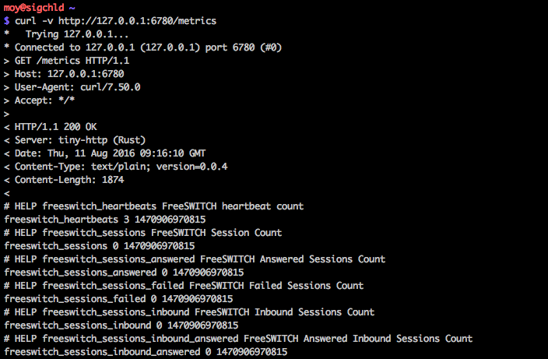
mod_prometheus
Test with curl

Slide 42
mod_prometheus
Use custom counters and gauges from the dialplan

Slide 43
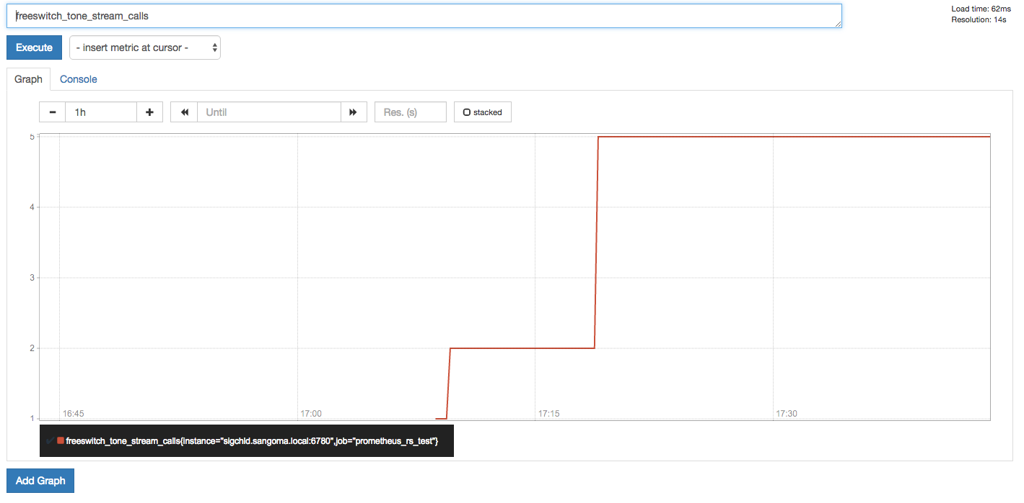
mod_prometheus
Next Prometheus scrap will get those metrics

Slide 44
Final Thoughts
Application instrumentation must be part of application development
Monitoring tools of all kinds are available. No excuses for lack of monitoring
Monitor all the things!

Slide 45
Afterword
Bringing Rust to FreeSWITCH. The mod_prometheus module is the first Rust module coming into FreeSWITCH
Rust is a new systems programming language within the same speed range as C/C++ but with memory safety guarantees using an ownership system and move semantics by default
Rust bindings are available by the freeswitchrs project created by Michael Giagnocavo: https://gitlab.com/wiresight/freeswitchrs/
Rust memory safety could make for an interesting addition to the stability of FreeSWITCH. If you’re writing modules please consider using Rust

Slide 46
QUESTIONS

Slide 47
Contact Us
Sangoma Technologies
100 Renfrew Drive, Suite 100 Markham, Ontario L3R 9R6 Canada
Website http://www.sangoma.com/
Telephone
+1 905 474 1990 x2 (for Sales)
Email sales@sangoma.com

Slide 48
THANK YOU

