Slide 1
Scaling FreeSWITCH Performance
ClueCon, August 2015
Moisés Silva <moy@sangoma.com>
Manager, Software Engineering

Slide 2
About Sangoma
Industry pioneer with over 25 years of experience in communications hardware and software
Publicly traded company since 2000
TSXV: STC
One of the most financially healthy companies in our industry
Growing, Profitable, Cash on the Balance Sheet, No Debt
Mid-market sized firm with just under 100 staff in all global territories
Offices in Canada (Toronto), US (CA, NJ), EU (UK & Holland), APAC (India), CALA (Miami)
World wide customer base
Selling direct to carriers and OEMs
Selling to the enterprise through a network of distribution partners
Notes:
Who knows about Sangoma?

Slide 3
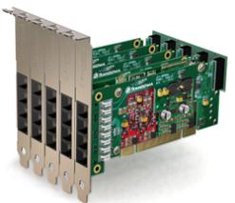
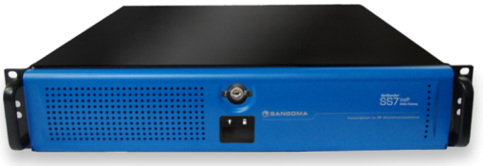
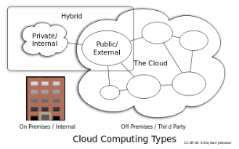
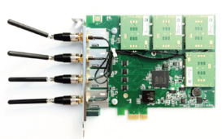
Broad Line of Great Products
Voice Telephony Boards
Analog/digital/hybrid, WAN, ADSL
Session border controllers
Microsoft Lync
VoIP Gateways
NetBorder SIP to TDM
SS7 to SIP
Software Applications
NetBorder Express, Call Progress Analyzer…
Transcoding (boards/appliances)
Fiber connectivity (STM1)
Wireless products (GSM)

Slide 4
We’re Hiring
Linux developers C/C++ or Python
Anywhere in the world, relocation paid or full time remote opportunities
Fun and relaxed work environment

Slide 5
Agenda
Performance Basics
FreeSWITCH Core Basics
Performance Tweaks
Feature Performance Cost
Final Thoughts

Slide 6
Performance Basics
Performance testing and measurement is hard to do and very prone to errors
Performance can change widely from seemingly minor hardware/software changes
This presentation focuses on Linux and SIP call bridging performance

Slide 7
Performance Basics
CPU-Bound
I/O Bound
Threads, Resource/Lock Contention
You cannot improve what you don’t measure

Slide 8
FreeSWITCH Core
FreeSWITCH is an insanely threaded system
(the good kind of insane)
Notes:
Part of learning to tweak performance is knowing the internals of FreeSWITCH so you know what you’re tweaking and when makes sense to do it
Being a heavily threaded system, many performance tweaks are meant to avoid thread contention on a shared resource (e.g db, locks, disk)

Slide 9
FreeSWITCH Core
Most threads are I/O bound
But transcoding, transrating, tone generation introduce CPU-bound elements into the mix
FreeSWITCH core I/O model is blocking, not async
Notes:
Part of learning to tweak performance is knowing the internals of FreeSWITCH so you know what you’re tweaking and when makes sense to do it

Slide 10
FreeSWITCH Core
Every call leg has its own session thread walking through a state machine, roughly, like this:
init -> routing -> execute app -> hangup -> reporting -> destroy

Slide 11
FreeSWITCH Core
Monitoring threads per signaling stack (e.g sofia, freetdm)
These threads are long-lived and perform very specific tasks (e.g process SIP signaling out of a call context, initial invite etc)
Event subsystem launches threads for event dispatch

Slide 12
FreeSWITCH Core
Conferences duplicate your use of threads per call leg. For each participant you have 2 threads:
Session thread (handles call state and media output)
Input conference thread (launched when joining the conference, reads media from the session)

Slide 13
FreeSWITCH Core
Even small features might launch threads
e.g. Setting timer=soft when performing a playback() launches an extra thread to consume media from the session

Slide 14
Performance Tweaks
Logging adds stress to the event subsystem
Every log statement is queued as an event
Every log statement is delivered to logger modules (syslog, file, console)
Set core logging level to warning in switch.conf.xml

Slide 15
Performance Tweaks
Do not write debug logs to an SSD in a loaded system. You’ll kill the SSD soon ☺
If you want to keep debug level, you can put logs into tmpfs and rotate often

Slide 16
Database
The native sqlite core database must go to tmpfs to avoid I/O bottlenecks
On tmpfs however you risk losing SIP registration data on a power outage or any sudden restart (e.g kernel panic)
Most other data is transient (e.g channels, sip dialogs, etc)

Slide 17
Database
Eventually you might need to migrate to pgsql, mysql or some other database via odbc
Allows you to move db workload elsewhere
Better performance for applications that read the core info (channels, calls, etc)

Slide 18
Database
Tables such as channels, calls, tasks, sip_dialogs, do not need to persist. You can move those tables to memory (e.g MEMORY engine on MySQL) if you don’t need fault tolerance
Remember to set auto-create-schemas=false and auto-clear-sql=false if you create the db schema on your own (see switch.conf.xml)

Slide 19
Database
If using MySQL:
Use the InnoDB engine for better concurrency in data that requires persistence (e.g SIP registration)
innodb_flush_log_at_trx_commit=0
sync_binlog=0

Slide 20
SIP Stack
Sofia launches the following threads per profile:
Main profile thread (runs sofia UA stack scheduling)
Worker thread (checks expired registrations)
Stack listener thread (accepting inbound traffic)
You can distribute your traffic among more sofia profiles for improved concurrency

Slide 21
Memory Allocation
FreeSWITCH uses memory pools
Using modules that depend on libraries or modules not using pools can benefit from using an alternative memory allocator

Slide 22
Memory Allocation
tcmalloc and jemalloc are good alternatives
Reports on the mailing list of improvement if using mod_perl
Sangoma found very significant improvement on its SBC (based on FreeSWITCH)

Slide 23
Memory Allocation
Easy to try on your own workload:
LD_PRELOAD=“libtcmalloc.so.x.x.x" ./freeswitch
Recommended to run mysql with either tcmalloc or jemalloc

Slide 24
Dialplan
Careful planning of your dialplan goes a long way
Do not enable functionality you don’t need, everything has a cost
Just loading a module might be consuming precious cpu cycles

Slide 25
Dialplan
Common performance factors to consider (mind the performance cost of those features):
Media relay
Tone Detection
Recording
Transcoding

Slide 26
Measurement Tools
switchy: A distributed load-generator
https://github.com/sangoma/switchy
vmstat plotter
https://clusterbuffer.wordpress.com/2014/09/21/vmstat_plotter/

Slide 27
Test Server
Linux CentOS 6 (kernel 2.6.x)
FreeSWITCH v1.4 git branch
Intel Xeon 64bit processor w/ 8 cores
Intel SSD
16GB of RAM

Slide 28
Test Lab
Load Generator
(FreeSWITCH)
Switchy
Load Generator
(FreeSWITCH)
ESL
ESL
Test FreeSWITCH Server
SIP
SIP

Slide 29
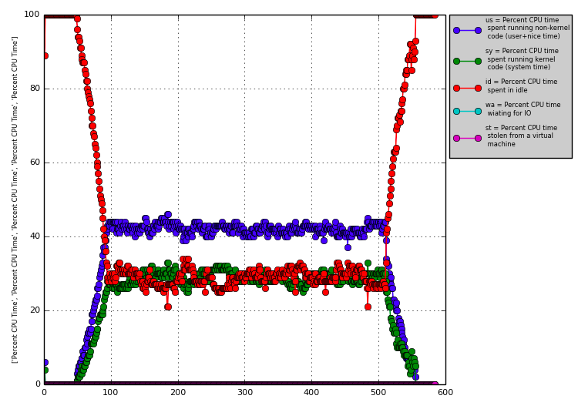
2k@50cps simple audio bridge

Slide 30
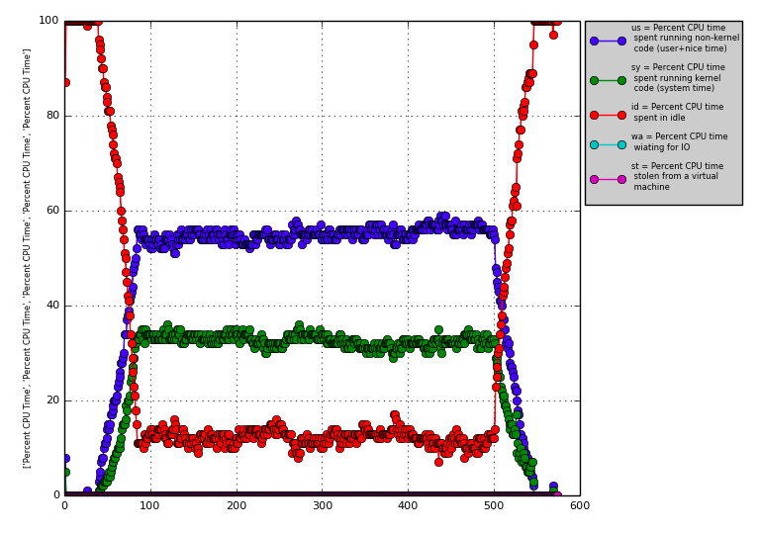
2k@50cps tone detection

Slide 31
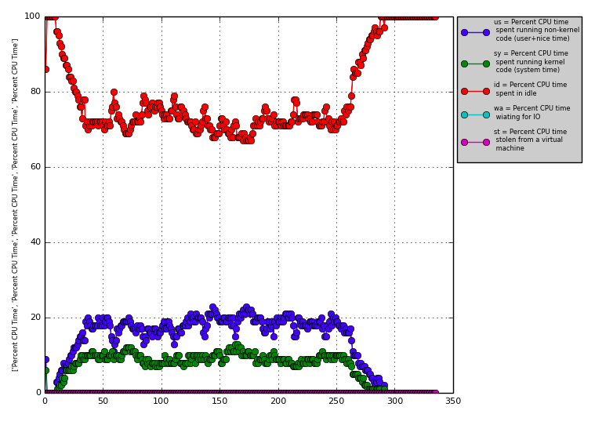
1k@50cps simple audio bridge

Slide 32
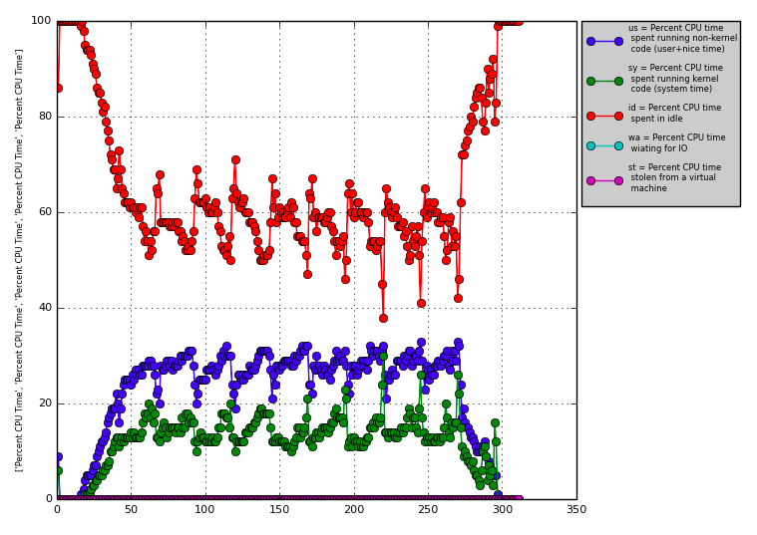
1k@50cps session recording

Slide 33
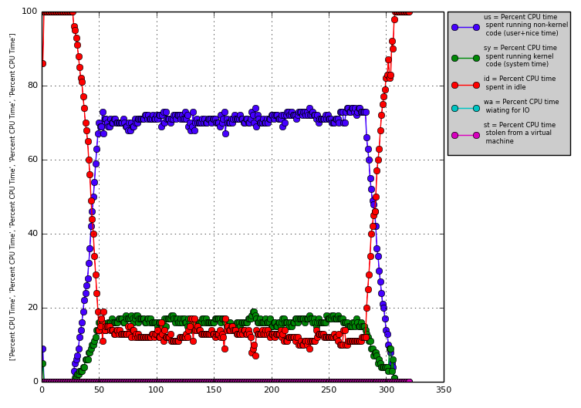
1k@50cps transcoding PCMU/G722

Slide 34
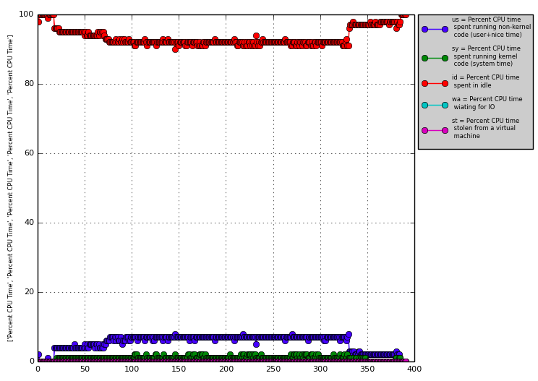
4k@80cps bypass media

Slide 35
Dialplan
Use bypass media selectively whenever you can
Avoid transcoding, use late-negotiation and inherit_codec=true
If you must do transcoding, you can offload to a hardware transcoder

Slide 36
Final Thoughts
You have to measure your own work load
No easy answers with performance, but you have the tools to find what works for you

Slide 37
QUESTIONS

Slide 38
Contact Us
Sangoma Technologies
100 Renfrew Drive, Suite 100 Markham, Ontario L3R 9R6 Canada
Website http://www.sangoma.com/
Telephone
+1 905 474 1990 x2 (for Sales)
Email sales@sangoma.com

Slide 39
THANK YOU

