Slide 1
SIP Testing w/ FreeSWITCH
ClueCon, August 2013
Moisés Silva <moy@sangoma.com>
Manager, Software Engineering

Slide 2
About Sangoma
Industry pioneer with over 25 years of experience in communications hardware and software
Publicly traded company since 2000
TSXV: STC
One of the most financially healthy companies in our industry
Growing, Profitable, Cash on the Balance Sheet, No Debt
Mid-market sized firm with just under 100 staff in all global territories
Offices in Canada (Toronto), US (CA, NJ), EU (UK & Holland), APAC (India), CALA (Miami)
World wide customer base
Selling direct to carriers and OEMs
Selling to the enterprise through a network of distribution partners

Slide 3
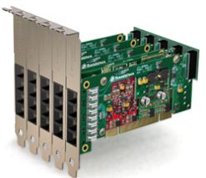
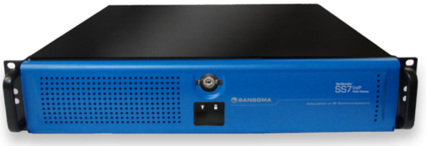
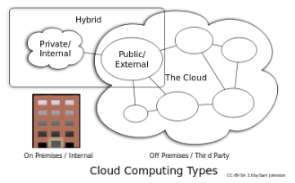
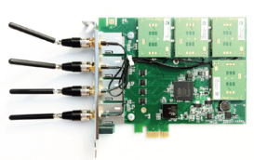
Broad Line of Great Products
Voice Telephony Boards
Analog/digital/hybrid, WAN, ADSL
Session border controllers
Microsoft Lync
VoIP Gateways
NetBorder SIP to TDM
SS7 to SIP
Software Applications
NetBorder Express, Call Progress Analyzer…
Transcoding (boards/appliances)
Fiber connectivity (STM1)
Wireless products (GSM)

Slide 4
Agenda
Testing Overview
Functionality Tests
Load Tests
Security Tests

Slide 5
Overview
I know, SIP testing can be scary

Slide 6
Overview
Testing complex systems requires detailed engineering and deep knowledge of OSes, wide range of protocols, hardware, etc
Not everyone likes doing it, it is not glamorous work …
But … It’s developer’s responsibility to test, not customer’s … shocking!

Slide 7
Overview
Lots of open source tools out there that can be used for testing:
Sipp
Sipsak
Sipvicious
Voiper
FreeSWITCH
Asterisk

Slide 8
Overview
Commercial tools as well
IXLoad from Ixia
SIP Hammer from Empirix

Slide 9
Overview
FreeSWITCH can be used to test other systems
Generate calls with full RTP wide array of codecs
Support for IPv4/IPv6, TLS, SRTP, STUN, ICE etc
Flexible programmable logic via XML, Python etc
Originate/terminate T.38 faxing
Originate/terminate SIP/TDM calls (and others)
Easy to hook up modules to test media or signaling:
Example: tone_detect, mod_bert, fs_test

Slide 10
Functionality Tests
Functionality Tests

Slide 11
Functionality Tests
Verify expected SIP behaviors
REFER actually places a new call to given destination
183 with SDP actually bridges media
4/5XX responses hang up or retry a call
REGISTER creates an AOR in your DB
… And you can go crazy with Presence tests …

Slide 12
Functionality Tests
Identify your most important functionality
Execute manual tests, take traces (pcap/wireshark)
Write test scenarios for them
Automate them! (Python/Ruby/PERL scripting)

Slide 13
SIPp

Slide 14
SIPp
FreeSWITCH Wiki SIPP Quote
“IF YOU DO NOT UNDERSTAND HOW TO STRESS TEST PROPERLY THEN DON'T BOTHER
Using SIPp is part dark art, part voodoo, part Santeria.
YOU HAVE BEEN WARNED”

Slide 15
SIPp
Low-level SIP functionality & performance test tool
Not super user-friendly, errors can go unnoticed
Requires a firm grasp on SIP (requests, responses, transactions, dialogs)
Flow logic is XML-based

Slide 16
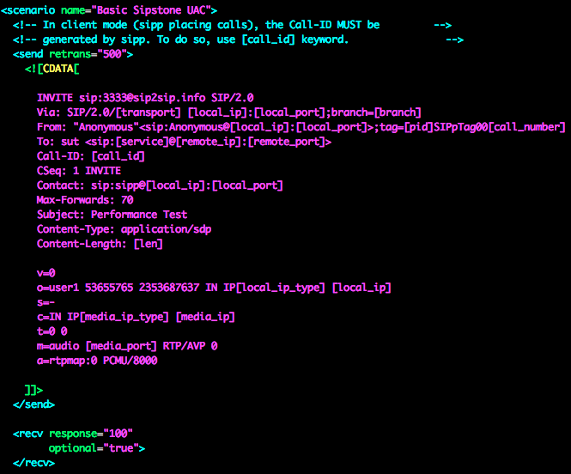
SIPp
Notes:
Sipp is in essentially sending and receiving sip messages … A far cry from santeria …. At least at this point ☺

Slide 17
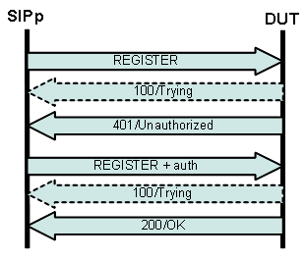
SIPp

Slide 18
SIPp
<send>, <recv>, <pause>, <exec>, rinse & repeat
<send> sends raw SIP messages
<recv> indicates you are expecting a SIP response or request
<pause> waits some milliseconds
<exec> Can be used to play a pcap (and other stuff)

Slide 19
SIPp
<send> takes care of re-transmissions if “retrans” attribute is used
<recv> blocks if non-optional
<exec> playing a file is non-blocking (surprising if you know FreeSWITCH/Asterisk playback)

Slide 20
SIPp
More complex scenarios can be created with conditional branching
Use statistical branching to add some variety to your scenarios
<pause> can be done using different distribution models such as normal, exponential, pareto, etc

Slide 21
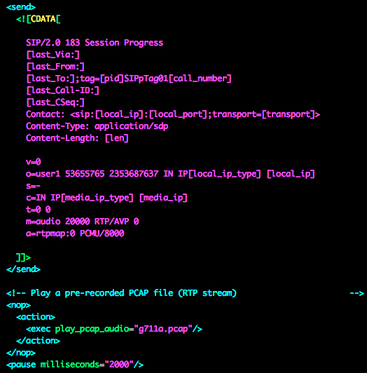
SIPp
Subtle mistakes can go unnoticed (no media)

Slide 22
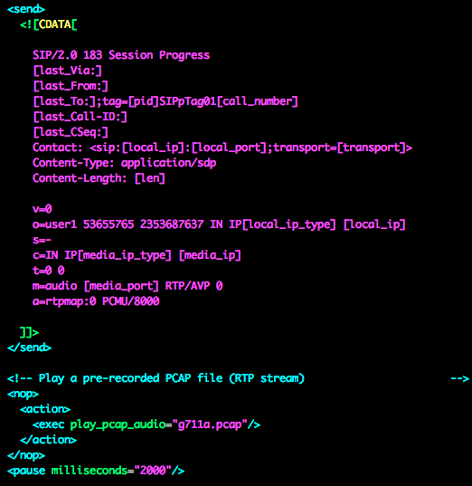
SIPp
Use [media_port] tag, do not hard-code ports in the SDP

Slide 23
SIPp
Make sure you use –rtp_echo
Make sure you insert a <pause> after playing a pcap and make sure the pcap is long enough
For load tests raise your process limits (ulimit –a for details)

Slide 24
SIPp
Automating creation of SIPp scenarios out of pcap captures:
Sippie
http://sourceforge.net/projects/sippie/
Sniff2sipp
http://svnview.digium.com/svn/sniff2sipp/

Slide 25
SIPSak
Mostly useful for flood tests
Much simpler/smaller than sipp, but less control
Easily used for RFC4475 testing (SIP Torture)

Slide 26
FreeSWITCH
You can create SIP flows indirectly using FreeSWITCH applications
No direct/raw SIP access, but possible through FreeSWITCH channel variables
Logic programmable in XML, Python, LUA etc

Slide 27
FreeSWITCH
Use ESL originate to send INVITEs
fs_test Python script mimics some SIPp options
https://github.com/moises-silva/fs_test
Control INVITE SIP headers through “sip_h_” originate variables
Send REFER with “deflect” application

Slide 28
FreeSWITCH
Send 180 with “ring_ready”
Send 183 with “pre_answer”
Send 200 with “answer”
Send 3XX with “redirect”
Send 4XX/5XX/6XX with “respond”
Send BYE with “hangup”

Slide 29
FreeSWITCH
G.711 media test / checking can be accomplished using mod_bert or tone_detect
https://github.com/moises-silva/freeswitch/tree/mod_bert
Calls failing the media test are hung up with MEDIA_TIMEOUT reason

Slide 30
Load Tests
Load Tests

Slide 31
Load Tests
Load testing can be a fine art
Be careful and define testing scope
OS (Linux, Windows, 64/32 bit, OS packages versions)
Media features (RTP/SRTP, UDPTL, Codec)
Signaling Features (TLS, PRACK, Presence, T.38)
Hardware environment (CPU, Memory, PCI/PCIx, HD)
Network environment (TCP/UDP/Ethernet settings)

Slide 32
Load Tests
Performance can vary widely when changing just a few environment characteristics, be sure to test after each change
Record your findings (ie: use Cacti)
Do no underestimate non-call-related load
Registrations, Presence, MWI, etc

Slide 33
Load Tests
Measure your network performance / throughput
Use good cat6 ethernet cables!
Use Iperf
https://code.google.com/p/iperf/

Slide 34
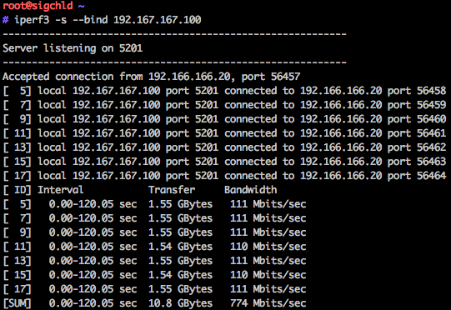
Load Tests
Launching iperf server

Slide 35
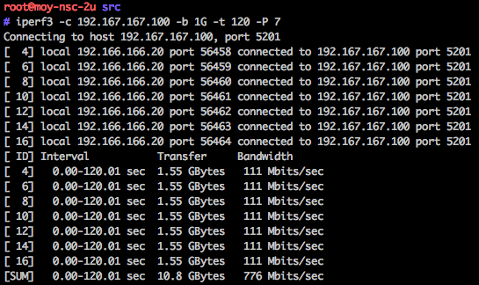
Load Tests
Launching iperf client

Slide 36
Load Tests
Do not forget to verify with bwm-ng
Iperf server bandwidth
Iperf client bandwidth

Slide 37
Load Tests
Slight payload change (iperf –l 172) causes significant performance difference
Iperf server bandwidth
Iperf client bandwidth

Slide 38
Security Tests
Security Tests

Slide 39
Security Tests
Sipvicious
Voiper

Slide 40
SipVicious
Sipvicious is handy to test your fail2ban rules
Use svwar.py and svcrack.py to trigger your fail2ban
Verify the host was blocked

Slide 41
Voiper
Voiper is handy for fuzzy/vulnerability testing
http://voiper.sourceforge.net/
Whatever you do, do not click on the last link at that page (UnprotectedHex)

Slide 42
Voiper
python fuzzer.py -f SIPInviteCommonFuzzer -i 192.168.168.1 -p 5060 -a sessions/scen1 -c 0
Tons of messages like this on FreeSWITCH:

Slide 43
Voiper
Note fail2ban can hardly help here (if at all)
Solution is report malformed packets via events and possibly block hosts sending excess of malformed traffic

Slide 44
QUESTIONS

Slide 45
Contact Us
Sangoma Technologies
100 Renfrew Drive, Suite 100 Markham, Ontario L3R 9R6 Canada
Website http://www.sangoma.com/
Telephone
+1 905 474 1990 x2 (for Sales)
Email sales@sangoma.com

Slide 46
THANK YOU

