Slide 1
FreeSWITCH as a Kickass SBC
Moises Silva <moy@sangoma.com>
Manager, Software Engineering

Slide 2
FreeSWITCH as a Kickass SBC
Moises Silva <moy@sangoma.com>
Manager, Software Engineering
Moises Silva <moy@sangoma.com>
Manager, Software Engineering

Slide 3
SBC: The Mythical Beast
No precise technical definition
Not standardized anywhere
B2BUA or Proxy?
Handles signaling or media?
More of a marketing term than technical?

Slide 4
SBC: The Mythical Beast

Slide 5
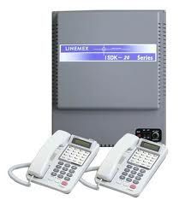
SBC: The Mythical Beast
Enterprise Network
Internet
PSTN
IP-PBX
S B C
SIP trunk
Telco
Intranet
ITSP
Internal Firewall
External Firewall
DMZ
SIP-Endpoints

Slide 6
SBC: The Mythical Beast
Carrier SBC sits at the edge of service provider networks
Enterprise SBC sits at the edge between customer and service provider

Slide 7
SBC: Definition
Recently loosely described by RFC 5853

Slide 8
SBC: Definition
Topology Hiding
Media Traffic Management
Fix capability mismatches
SIP NAT
Access Control
Protocol Repair
Media Encryption
Threat protection (ie: DoS, Malformed packets)

Slide 9
Topology Hiding
Hide the service provider or enterprise network implementation details
Use of RFC 3323 (privacy) not enough
B2BUA required in most cases

Slide 10
Topology Hiding
INVITE before topology hiding

Slide 11
Topology Hiding
INVITE after topology hiding

Slide 12
Topology Hiding in FreeSWITCH
FreeSWITCH is a B2BUA
Header manipulation using SIP dialplan variables
Do not enable SDP pass-thru (bypass_media=true)

Slide 13
Topology Hiding Cons
It is a B2BUA!
Breaks end to end security mechanisms such as RFC 4474
Obviously no difference from a MITM attack

Slide 14
Media Traffic Management
SBC may modify SDP to stay in media path
Operators enforce the use of certain codecs
Single point for audition (ie Lawful Interception)

Slide 15
Media Traffic Management
SDP before media management

Slide 16
Media Traffic Management
SDP after media management
Session attribute removed enforcing a policy

Slide 17
Media Traffic Management
Allows operators to use different billing model according to the media type (Voice, Video, Text)
Fix ‘lost’ or ‘ignored’ BYE issue
QoS based routing

Slide 18
Media Traffic Management in FreeSWITCH
Flexible codec configuration in SIP profiles or dialplan
Media timeout via SIP profile configuration or channel variable “rtp_timeout_sec”
Flexible SDP manipulation thru variables

Slide 19
Media Traffic Management in FreeSWITCH
Set codec preferences
SDP manipulation

Slide 20
Media Traffic Management in FreeSWITCH
Use record_session for local recordings
Use oreka_record to send media to recording server (pending merge on official git repo)
git@github.com:moises-silva/freeswitch.git

Slide 21
Media Traffic Management in FreeSWITCH
FreeSWITCH
G.722
G.729
SIP UA
SIP UA
G.711
Oreka
Recording
Server
(orkaudio)

Slide 22
Media Traffic Management Cons
Increase length of media path
SBC must be aware of all types of media, slowing adoption of new media features

Slide 23
Fix Capability Mismatches
Allow interconnection of user agents with different capabilities (ie: codecs)
IPv4 to IPv6 internetworking
SIP over UDP to TCP etc

Slide 24
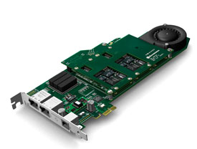
Fix Capability Mismatches in FreeSWITCH
Virtually every codec in the industry
HD voice codecs such as G.722 and Siren 7
Hardware transcoding available

Slide 25
Fix Capability Mismatches in FreeSWITCH
SIP over UDP/TCP/TLS
IPv4 and IPv6 support

Slide 26
Fix Capability Mismatches
G.729 / TLS / IPv6
G.711 /
UDP /
IPv4
FreeSWITCH
SIP UA
PRI GW

Slide 27
SIP NAT
Detect when a UA is behind NAT
Help maintain NAT bindings alive
Provides a publicly reachable IP address

Slide 28
SIP NAT in FreeSWITCH
Automatic RTP adjustment when media comes from different address than advertised on SDP
Aggressive NAT detection
STUN and ICE support

Slide 29
Access Control
It’s all about control, yes, sys admins are control freaks
The network edge of the operator or enterprise is a convenient place to enforce policies
All SIP and RTP traffic to/from a single point (the SBC)

Slide 30
Access Control in FreeSWITCH
Flexible ACL configuration available
mod_limit for call rate and general resource limiting per IP or ‘realm’
Distributed limits across servers

Slide 31
Protocol Repair
The world isn’t perfect, broken devices are everywhere
Not feasible to throw all broken equipment to the garbage (that’d be too easy wouldn’t it?)

Slide 32
Protocol Repair in FreeSWITCH
Allows matching and fixing of SIP header values
Allows modifying SDP contents
Not always possible, SIP stack may discard messages if deemed malformed (ie FUBAR)

Slide 33
Media Encryption
Desirable to perform encryption on public network
Internal network may need un-encrypted media (ie, lawful interception, endpoints without SRTP support)

Slide 34
Media Encryption in FreeSWITCH
TLS / SRTP support
ZRTP / SRTP support

Slide 35
Threat Protection
DoS
Malformed and/or malicious packets
SIP REGISTER scans (ie: sipvicious)
SIP INVITE scans

Slide 36
Threat Protection for FreeSWITCH
DoS limitation using iptables hashlimit (Kristian’s famous script)
iptables hashlimit does not work on TLS obviously
iptables hashlimit does not help with malformed packets

Slide 37
Threat Protection for FreeSWITCH
Fail2ban for registration scans
Depends on log line format, good enough?
mod_fail2ban makes things easier (by kyconquers on github)

Slide 38
Threat Protection
Use SIP ACLs
Even trusted networks can become compromised
IP spoofing on UDP traffic makes things complicated

Slide 39
Sofia Limits
Extension to mod_sofia to specify SIP message limits, per host optionally (no ACL yet ☹)
Uses mod_hash (or any limit interface) to keep track of messages
Launch ESL event when limit is exceeded
Malformed packets are accounted for as well

Slide 40
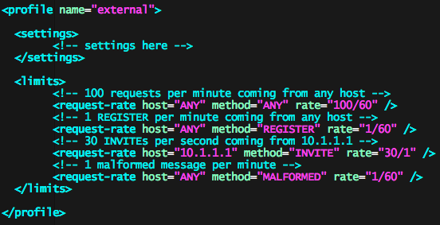
Sofia Limits

Slide 41
Conclusion
Yes, SBCs get in the way, and that’s a useful and desirable feature in some businesses
FreeSWITCH core foundations go a long way in implementing most common SBC features

Slide 42
Thank you.

