Slide 1

Integration at the Edge
TDM/IP and IP/IP
Technology Summit
Niagara Falls, July 18, 2013
Moisés Silva
Manager, Software Engineering
msilva@sangoma.com

Slide 2
Agenda
About Sangoma
VoIP deployment challenges
Portfolio of Gateways
Portfolio of Session Border Controllers
Closing

Slide 3
About Sangoma
Industry pioneer with over 25 years of experience in communications hardware and software
Publicly traded company since 2000
  TSXV: STC
One of the most financially healthy companies in our industry
  Growing, Profitable, Cash on the Balance Sheet, No Debt
Mid-market sized firm with just under 100 staff in all global territories
  Offices in Canada (Toronto), US (NJ), EU (UK & Holland), APAC (India), CALA (Miami)
World Wide Customer base
  Selling direct to Carriers and OEMs
  Selling to the Enterprise through a network of distribution partners

Slide 4
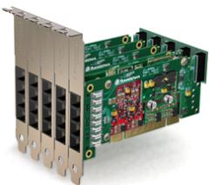
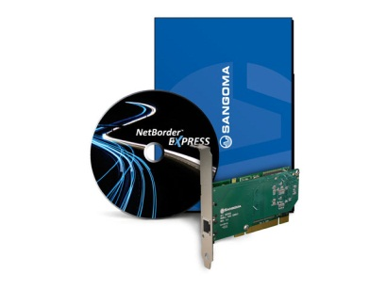
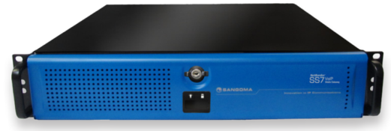
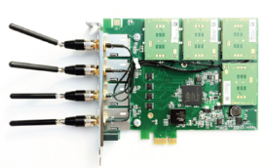
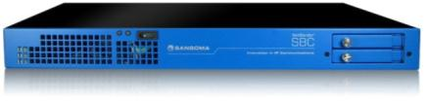
Broad Line of Great Products
Voice Telephony Boards
  Analog/digital/hybrid, WAN, ADSL, etc
Software Applications
  NetBorder Express, Call Progress Analyzer…
Gateways
  NetBorder SIP to TDM
  SS7 to SIP
Wireless Products
Session Border Controllers
Microsoft Lync
Fiber connectivity (STM1)
Transcoding (boards/appliances)

Slide 5



















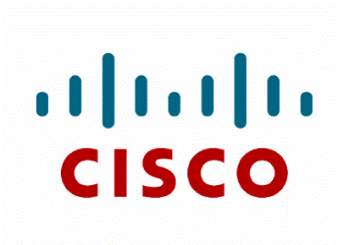




Vibrant Ecosystem of Clients & Partners
Open Source Telephony
Ready to use drivers for Sangoma boards
Proprietary PBX and IVR
Plug-in to major soft-PBX and IVRs
Contact Center
OEM Integration with major software suites
Carriers, Cloud, Data Ntwks
Proven Infrastructure Technology

Slide 6






















Innovation and Interoperability
Indian Army

Slide 7
VoIP is now mainstream
Yes, for sure but …
There are still a lot of legacy pockets/islands
We are still in a transition phase from legacy to VoIP
This drives the need to interconnect legacy networks with VoIP Networks
  In the core and at customer premises
And VoIP to VoIP Networks also brings its own set of challenges at the edge

Slide 8
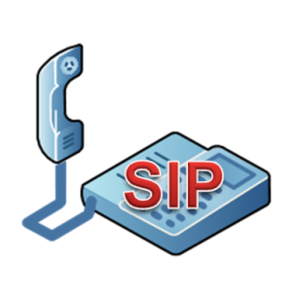
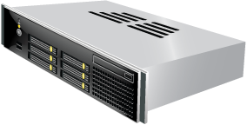
Typical VoIP Service Provider Network
PSTN
SS7
VoIP GW
Softswitch
Broadband
Router
Voice
VoIP
VoIP
Access
Session Border Controller
VoIP GW
IP Network
PSTN
SS7
IP PBX
VoIP
Voice
VoIP
VoIP
VoIP
Legacy
PBX
Peering
Session Border Controller
In VoIP Networks, SIP has become the standard of choice
VoIP GW
IP Peering
Core
Access

Slide 9
Integration at the Edge
PSTN interconnection requires VoIP Gateways
  SS7 to VoIP Gateway in the core
  Enterprise VoIP Gateways for customer premises (enterprise, Soho, residential)
    SIP Trunking into legacy PBXs
    SIP to analog line conversion (phones or key systems)
VoIP to VoIP brings its own challenges
  Creates the need for Session Border Controllers
  We will come back on this one later

Slide 10
Enterprise Gateways
Vega Series

Slide 11
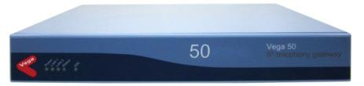
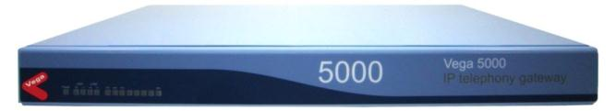
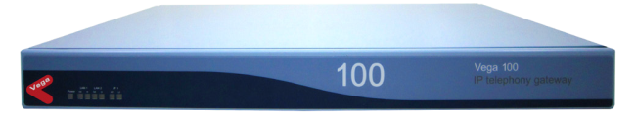
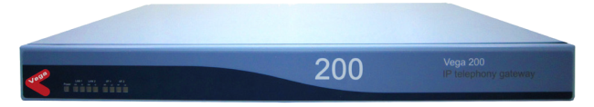
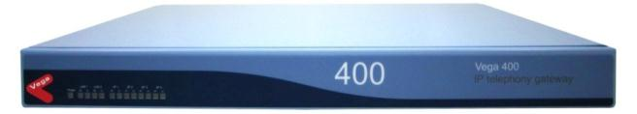
Vega Series: Telecom Appliances
Vega 50
  H.323 / SIP
  Up to 8 port BRI
  Up 10 ports FXO/FXS combos
Vega 5000
  H.323 / SIP
  24 or 50 ports FXS
  2 FXO failover to PSTN
Vega 100, 200, 400
  8 to 120 VoIP calls H.323 / SIP
  Up to 4 T1/E1 (PRI, CAS)
  Power fail hardware
  Expandability and upgrades
    DSP modules
    Software license

Slide 12
Features – All Gateways
VoIP Protocols
  SIP or H.323
  TLS / SRTP for security
Dual LAN + Console Port
Management
  Web GUI
  CLI
  RADIUS
  SNMP
  Syslog
  Billing logs
Powerful call routing capabilities
Remote Firmware Upgrade
Vocoding
  G.711, G.729, G.723, G.726
G.168 Echo
Cancellation
T.38 Fax relay
Enhanced Network Proxy for failover

Slide 13
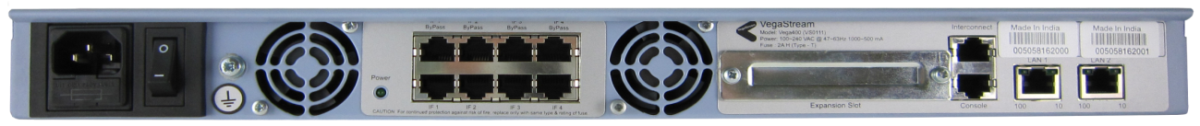
Vega Provisioned for By-Pass
Hot Stand-By Gateway
E1/T1 cables
Primary Gateway
To/From
Telco
E1/T1 cables
Notes:
If the Power to the Main Unit Fails the Relays Close [Click]
The Main Unit is now in BYPASS and the Hot Stand-By Unit is handling all call routing. The Main Unit is invisible to the circuit.

Slide 14
Operating in By-Pass Mode
Hot Stand-By Gateway
Internal relay trips to connect to by-pass ports
Primary Gateway
To/From
Telco
T1/E1 cables

Slide 15




SIP Trunking
ITSP
SIP /
VoIP
The TDM-Based PBX can use SIP Trunks to reduce cost and improve flexibility
Analog
BRI
PRI
Legacy PBX
PBX, TDM
Endpoints

Slide 16

SIP Trunking with Resilience
ITSP
SIP /
VoIP
PSTN
Analog
BRI
PRI
Vega reroutes all calls to the PSTN if:
SIP/WAN/Internet fails
Power Fails to Gateway
Legacy PBX
PBX, TDM
Endpoints

Slide 17
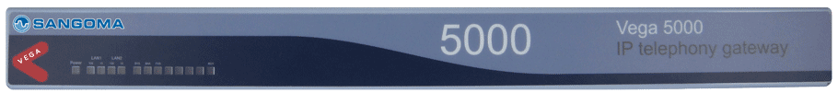


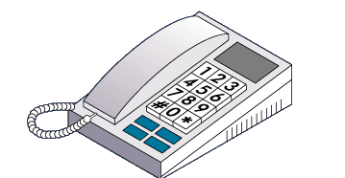


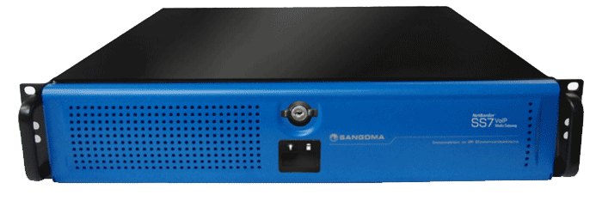
SIP Dial Tone/Multi-Dwelling Units
VoIP Service Provider
24 or 50 analog FXS long reach lines
LAN
Softswitch
Tenant 1
Session Border Controllers
IP
Network
IP Router
Tenant 2
IP Router
Carrier SS7 GW
Tenant 3
MDU
SS7 PSTN
SIP
Peering
Tenant N

Slide 18
SNAP TOOL
Sangoma Network Appliance Provisioning Tool simplifies provisioning and deployment of gateways for use on Interoperability Partners’ networks
  Sangoma builds standard configuration files for an Interoperability Partner
  Through the Snap Tool, user provides installation specific info (IP Address, User_Name, Password, etc.)
  Snap Tool automatically builds a provisioning template that can be instantly uploaded to the gateway
We can work with you to add your SIP trunking service on SNAP

Slide 19
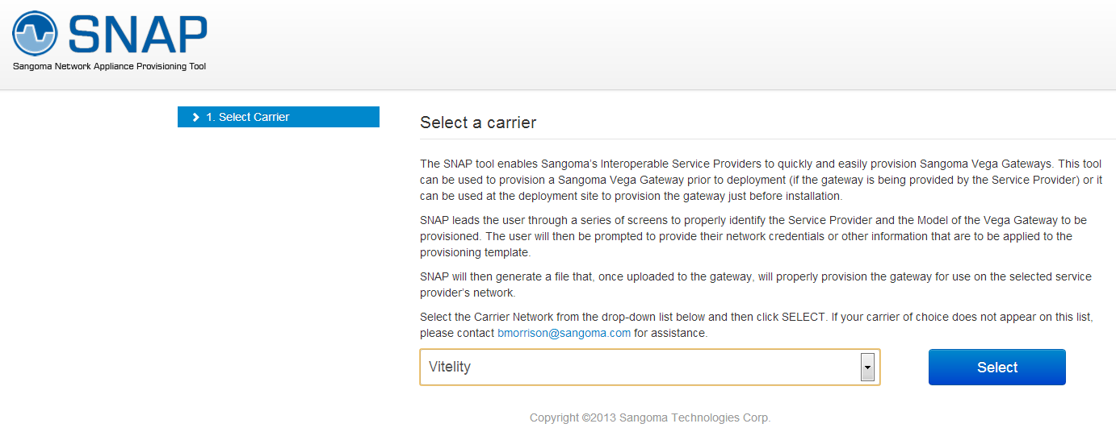
Step One: Select a Carrier

Slide 20
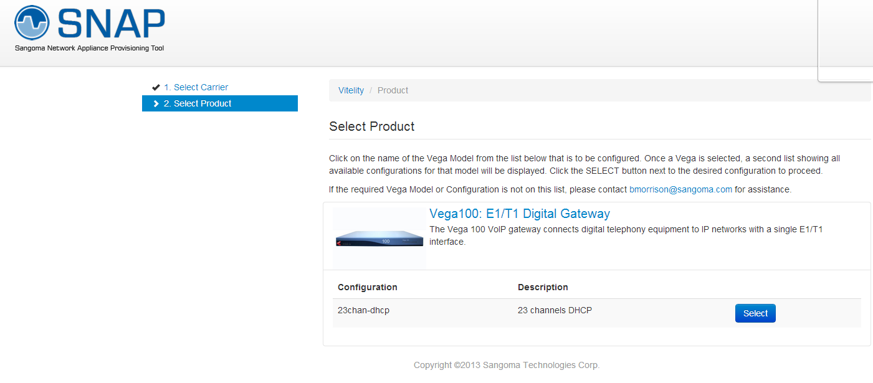
Step Two: Select Gateway

Slide 21
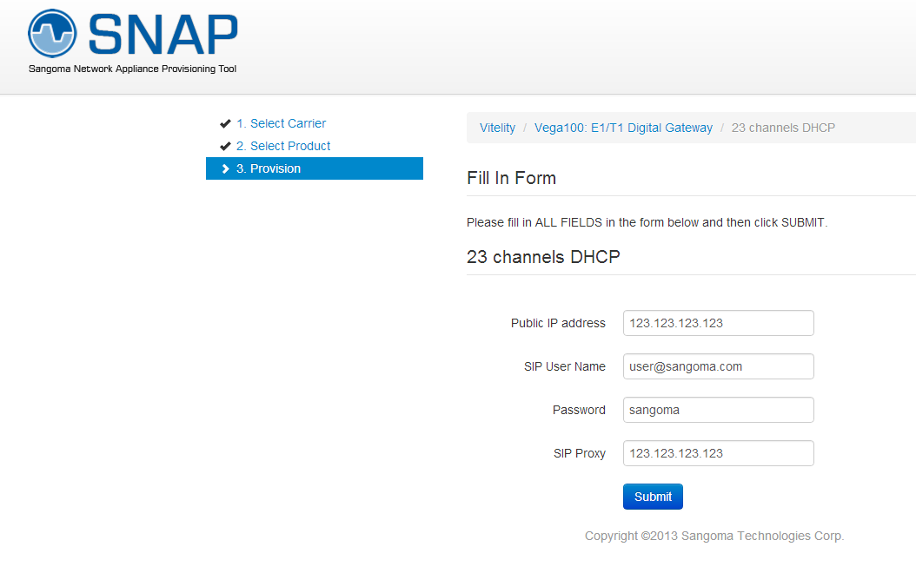
Step Three: Add Specifics

Slide 22
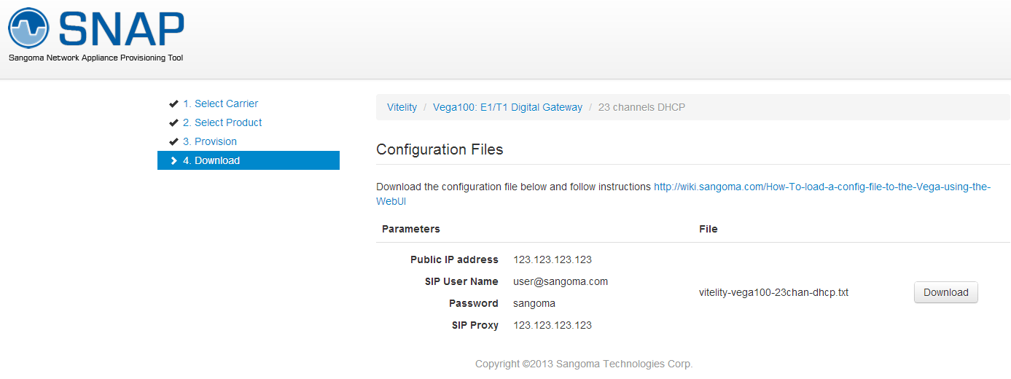
Step Four: Download Template

Slide 23
SS7 Gateways
NetBorder Series

Slide 24
NetBorder SS7 Gateway Features
Up to 32 T1/E1 per server
Can scale up to 288 E1s in relay mode where multiple systems act as one
SS7 ISUP Signaling with several national variants
  ITU, ANSI, Bellcore, France, UK, China, India and Russia
Wide range of narrowband and wideband codecs supported
  for any to any codec transcoding
Robust implementation with distribution, failover and redundancy
Flexible XML based routing rules for call control
Coming Features:
  T.38 and SIP REFER support
  Sigtran relay and termination
  Megaco / H.248 support for enhanced Softswitch integration

Slide 25
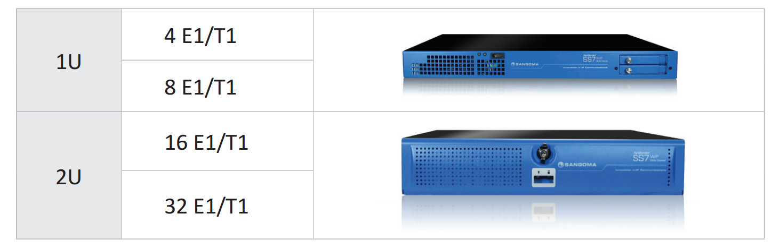
Deployment Options

Slide 26
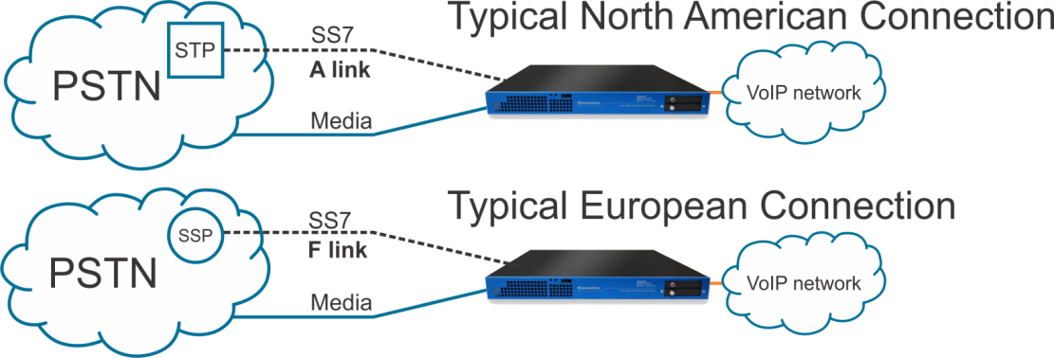
SS7 Gateway Place on Network
SS7 signaling to gateway is like an SSP on the PSTN network
Signaling connects directly to SSP or STP equipment
  Connects to STP node via an A link (typical North American)
  Connects to SSP node via an F link (typical European)
These are not yet supported: CNAM, LIDB, LNP
or anything SCCP (TCAP, MAP or INAP)
Notes:
This slide is primarily to educate sales people, and probably should not be presented to customers.
If you are asked about CNAM, LIDB, LNP, or any SCCP functionality, please not the request and forward it to the marketing department for tracking.

Slide 27
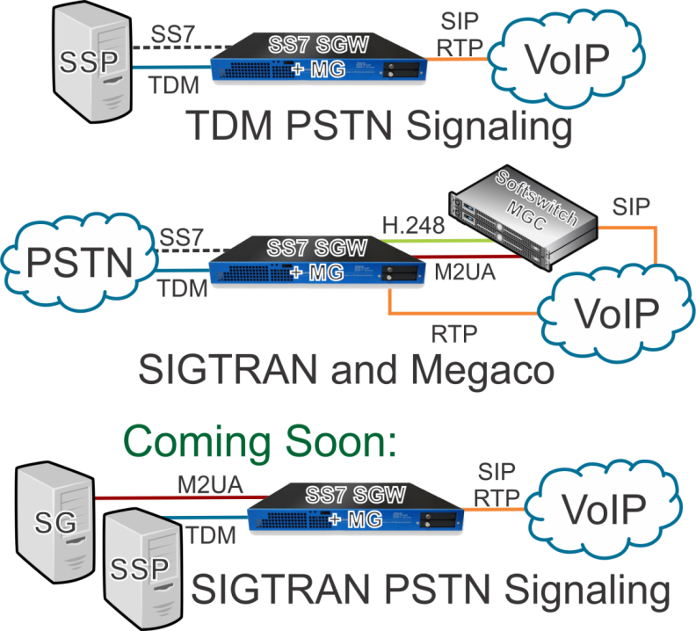
SS7 to VoIP Inter-Working

Slide 28
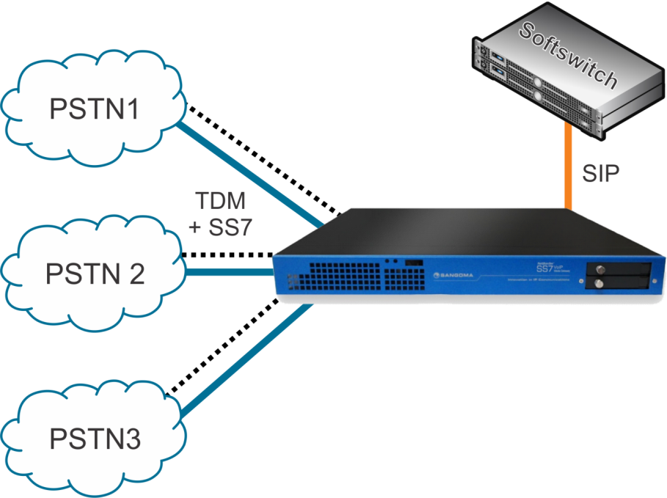
Access Gateway for SIP Softswitch
Provides inter-carrier TDM access to SIP-only based Softswitch
Interconnection to several service providers
Centralized call control for carriers in distributed networks
Softswitch performs routing, billing, subscriber management
Notes:
Voice may be routed entirely by PSTN, with this solution handling signaling.
RTP may be added to provide cheaper voice transport via IP

Slide 29
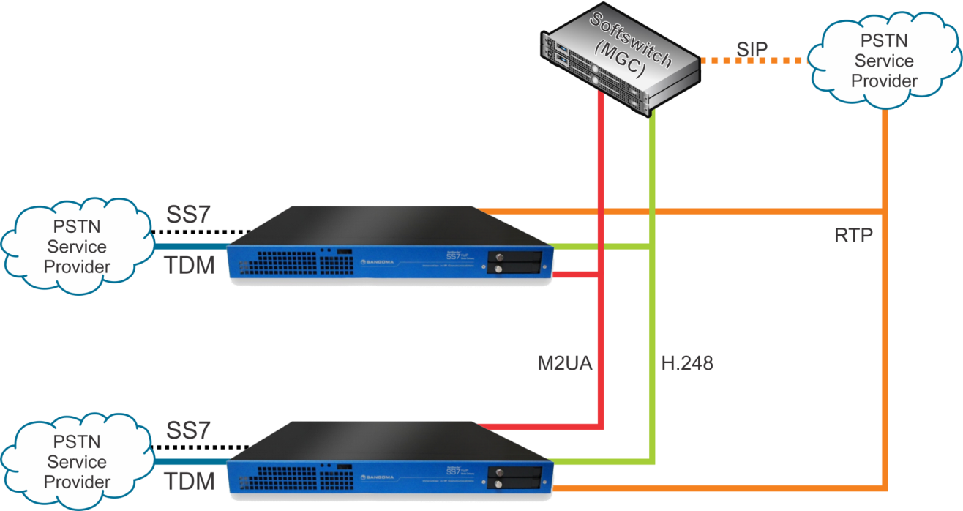
Access Gateway for Megaco Networks
Combined SGW (signalling gateway) and MG (Media Gateway)
Leverages Central Control (MGC) Carrier Infrastructure in large distributed networks
Softswitch (MGC) performs signalling, routing, billing, subscriber management, etc.
Megaco: Media Gateway Control Protocol (aka H.248)
Notes:
An alternate method for connecting calls between PSTN networks if Megaco (H.248) is preferred over SIP.

Slide 30
VoIP to VOIP integration challenges
Integration at the Edge

Slide 31
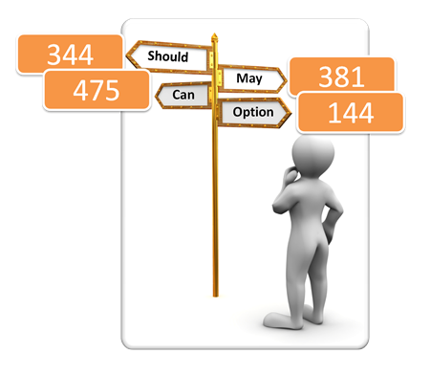
End to End VoIP interworking challenges
SIP is it! RFC3261
But while it is the largest RFC around, easy to end up with incompatible SIP end-points
Quick search in RFC for words such as Should, Can, May, Options! It’s pretty loose!

Slide 32
Other challenges
Solve firewall and NAT issues (ALG) without compromising security / integrity of networks
Normalize sip messaging
Fix errors in the sip messaging stream
Register sip trunks with ITSP
Secure SIP & voice (TLS, SRTP, IPSEC)
Codec conversion
Manage QoS settings and SLA
Provide access to remote users
This is what SBC’s do!

Slide 33
Security Threats with VoIP
Denial of Services
  Call/registration overload
  Malformed messages (fuzzing)
Configuration errors
  Mis-configured devices
  Operator and application errors
Theft of service / Fraud
  Unauthorized users
  Unauthorized media types
BYOD
  Smartphones running unauthorized apps
  Viruses and Malware attacking your VoIP network
Denial of Services
  Call/registration overload
  Malformed messages (fuzzing)
Configuration errors
  Mis-configured devices
  Operator and application errors
Theft of service / Fraud
  Unauthorized users
  Unauthorized media types
This is what SBC’s do!

Slide 34
Portfolio of
Session Border Controllers

Slide 35

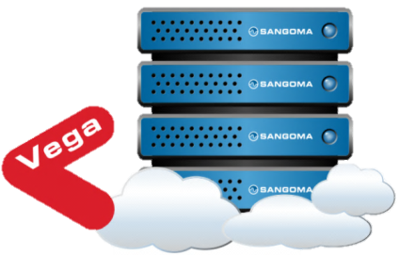
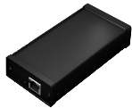

Session Border Controllers
Vega Enterprise SBC
  25-250 Sessions/Calls
Vega VM Enterprise SBC
  25-500 Sessions/Calls
  Software Only/Virtual Machine Ready
Vega VM/Hybrid Enterprise SBC
  SANGOMA EXCLUSIVE
  25-500 Sessions/Calls
  SBC Maintained in VM
  Media Functions offloaded to external hardware resource
NetBorder Carrier SBC
  250-4000 Sessions/Calls

Slide 36
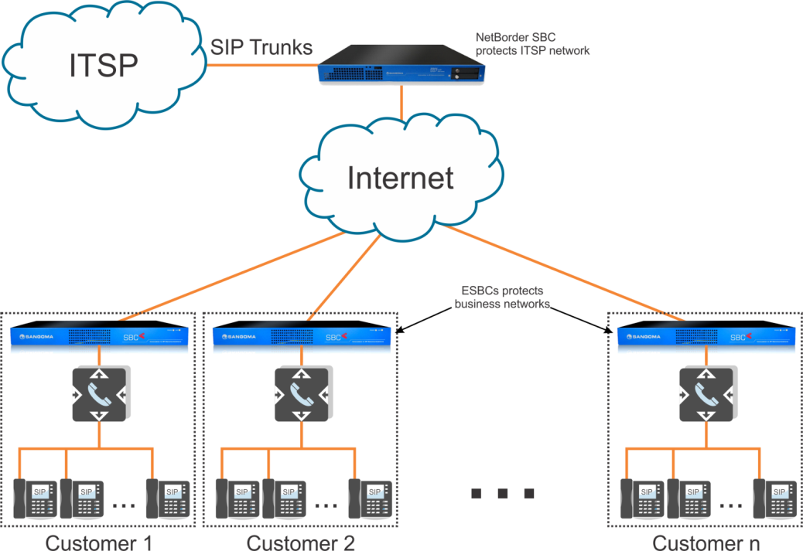
SIP Trunking
This NetBorder SBC
protects the ITSPs network
Notes:
Advantages
Known demarcation point
Reduces interop issues/resource with core
Transcoding if required

Slide 37
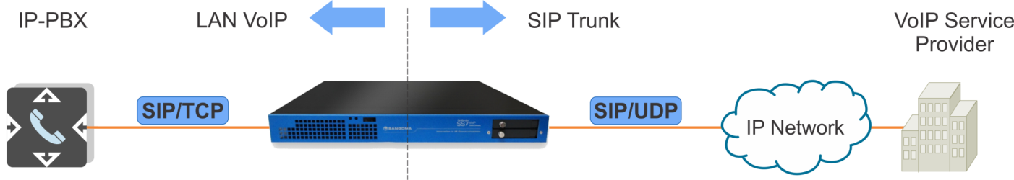
SIP Signalling Conversion
Convert SIP over TCP to SIP over UDP
Some devices require SIP/TCP
  e.g. Microsoft Lync

Slide 38
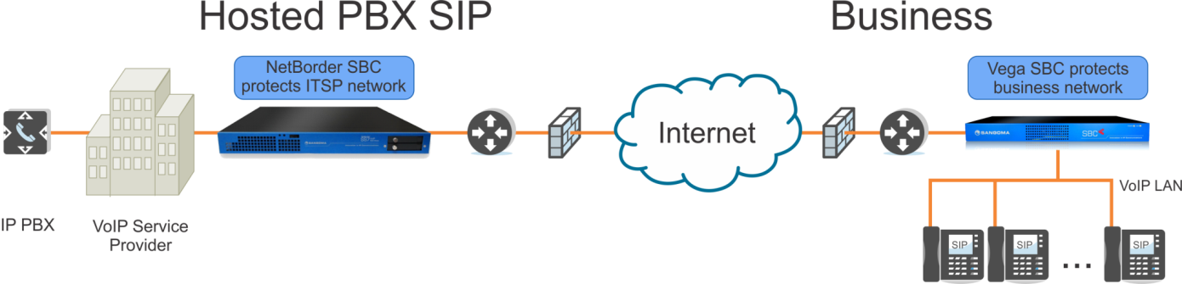
SBC For Hosted PBX
Known demarcation point
Reduces interoperability issues with core
Transcoding if required

Slide 39
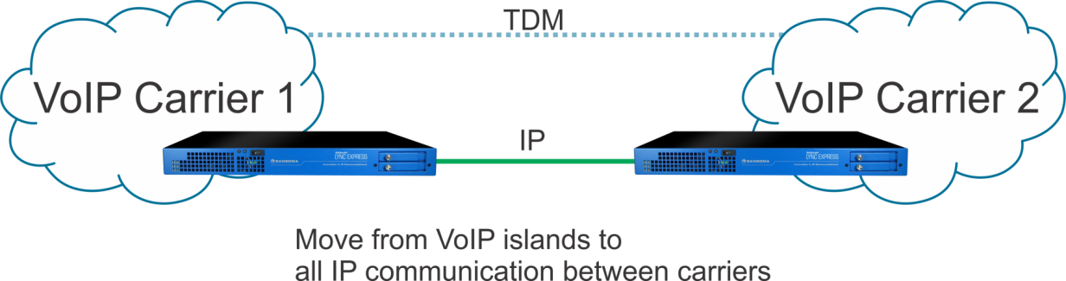
SIP Network Peering/
IP Carrier Interconnect
Use IP for inter-carrier links
No TDM conversion required:
  Decrease complexity
  Better voice quality, less delay, less transcoding

Slide 40
Simple Licensing
Simple per session licensing
  No Per Feature, Per User or Per Codec licensing
Predictable SBC capacity and cost in every use case

Slide 41
Closing

Slide 42
Closing
Transition from Legacy to VoIP is still happening
  Drives the need for VoIP Gateway
End-to-end VoIP networks introduce new challenges
  Drive the need for Session Border Controllers
Sangoma provides a portfolio of products that suit small and large service providers

Slide 43
Thank You!
Questions?

