Slide 1
Implementation Lessons using WebRTC in Asterisk
Astricon, October 2013
Moisés Silva <moy@sangoma.com>
Manager, Software Engineering

Slide 2
Agenda
WebRTC Intro
WebRTC Asterisk Architecture
Install & Config
Troubleshooting

Slide 3
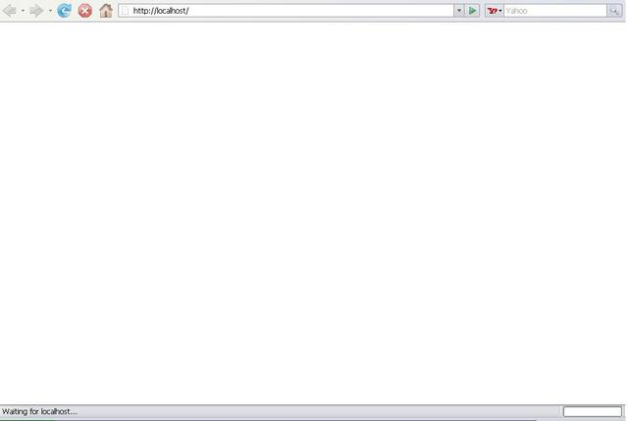

WebRTC Intro
It is not a phone in the browser!

Slide 4
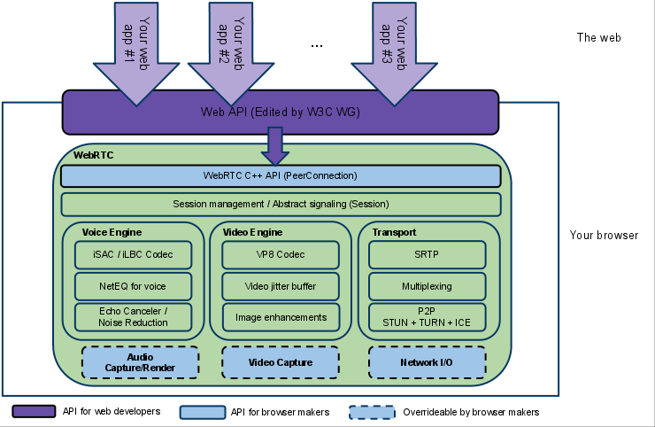
WebRTC Intro
It is a full RTC engine in the browser!

Slide 5
WebRTC Intro
Yes, it can be used for a phone in the browser ☺

Slide 6
WebRTC Intro
Full media engine API in the web browser
No “call” or “session” signaling defined
Generic data interchange between browsers, peer to peer
State of the art NAT traversal techniques

Slide 7
WebRTC Intro
WebRTC comes with multiple APIs, ie:
  Peer-to-Peer Connections (RTCPeerConnection)
  Peer-to-Peer Data API (RTCDataChannel)
  Statistics (RTCStats)
  Media Stream (getUserMedia)

Slide 8
WebRTC Intro
WebRTC uses established protocols:
  SRTP/SRTCP for media exchange (secure RTP)
  SDP (its use is controversial and currently challenged)
  ICE, STUN, TURN for NAT Traversal
  DTLS for key exchange
  G.711, Opus, VP8/H.264 etc; for voice and video

Slide 9
WebRTC Intro
What signaling to use is up to you:
  SIP
  XMPP/Jingle
  RESTful API (json)
  OpenPeer ….

Slide 10
WebRTC Intro
Applications
  A phone, video calls, conferencing etc!
  Video games
  P2P Video Streaming (Chromecast)
  Motion-detecting Baby Monitor (https://github.com/webrtcHacks/webrtc_baby_monitor)

Slide 11



WebRTC Intro
WebRTC Web Triangle
Web
Signaling
Signaling
Encrypted Media
Alice’s Browser
Bob’s Browser

Slide 12

WebRTC in Asterisk
SIP over WS
SIP over WS
Encrypted Media
Encrypted Media
Alice’s Browser
Bob’s Browser

Slide 13
WebRTC in Asterisk
WebRTC Gateway
SIP/RTP, Jingle, FXO/FXS,
PRI, SS7 etc …
SIP over WS
Encrypted Media
Alice’s Browser

Slide 14
WebRTC in Asterisk
Javascript SIP
res_http_websocket
chan_sip
WebRTC
res_rtp_asterisk
res_srtp

Slide 15
WebRTC in Asterisk
sipml5
Asterisk 11
Chrome 30

Slide 16
Installing WebRTC Support
Make sure you have:
  libuuid-devel (required by res_rtp_asterisk)
  OpenSSL w/ DTLS support (1.0.1e has SSL_CTX_set_tlsext_use_srtp)
  libsrtp-devel

Slide 17
Installing WebRTC Support
Easy usual steps …
  ./configure
  make menuselect:
    res_http_websocket
    res_rtp_asterisk
  make install

Slide 18
Configuring WebRTC Support
Enable the websockets server (http.conf)
  enabled=yes
  bindaddr=0.0.0.0
  bindport=8088

Slide 19

Configuring WebRTC Support
Good idea to use secure websockets (http.conf)
  tlsenable=yes
  tlsbindaddr=0.0.0.0:8089
  tlscertfile=localhost.crt
  tlsprivatekey=localhost.key

Slide 20
Configuring WebRTC Support
But … Asterisk currently seems to have issues with secure WebSockets, patches available to fix them
  https://issues.asterisk.org/jira/browse/ASTERISK-21930
  http://svnview.digium.com/svn/asterisk/team/moy/webrtc-11/

Slide 21
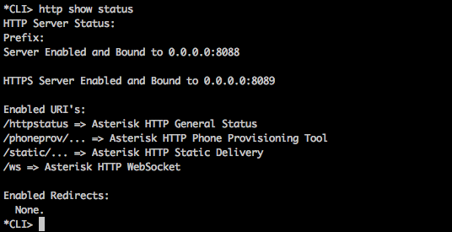
Configuring WebRTC Support
Verify the HTTP server status

Slide 22
Configuring WebRTC Support
Test websockets connectivity
  npm install –g ws
  wscat –s echo –c ws://<host>:<port>/ws
  wscat –s echo –c wss://<host>:<port>/ws

Slide 23

Configuring WebRTC Support
Test websockets connectivity

Slide 24
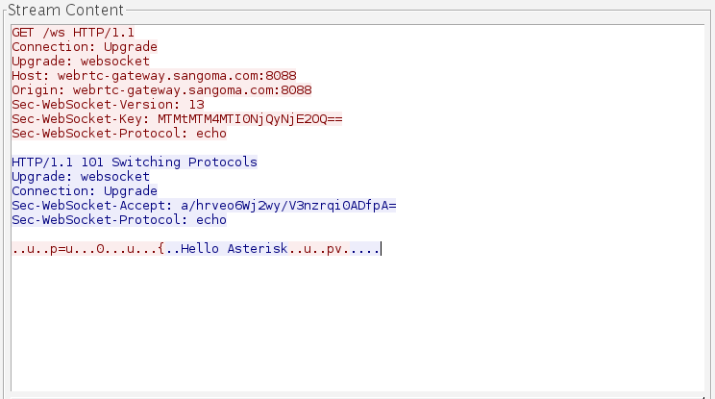
Configuring WebRTC Support

Slide 25
Configuring WebRTC Support
Enable SIP over websockets (sip.conf)
  transport=udp,ws,wss
  Make sure you use the /ws URL when connecting from JavaScript

Slide 26
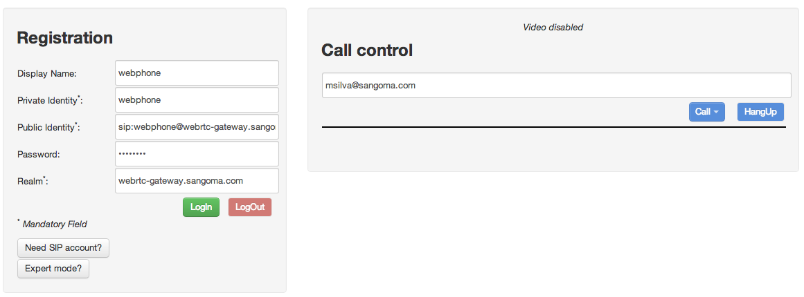
Configuring WebRTC Support
Testing using sipml5.org/call.htm

Slide 27
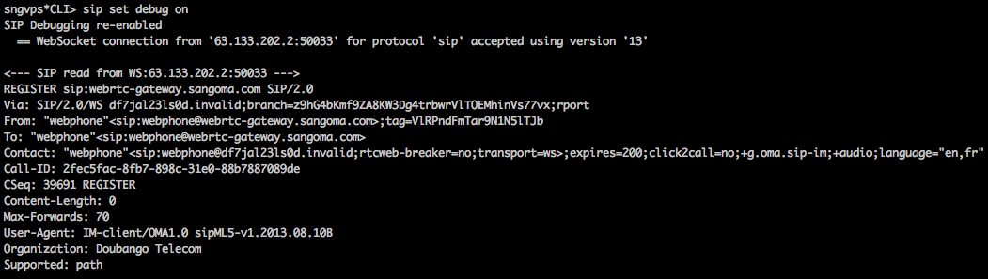
Configuring WebRTC Support

Slide 28
Troubleshooting
Troubleshooting Toolkit
  javascript console
  chrome://webrtc-internals
  Node ws (test websockets)
  Wireshark!

Slide 29
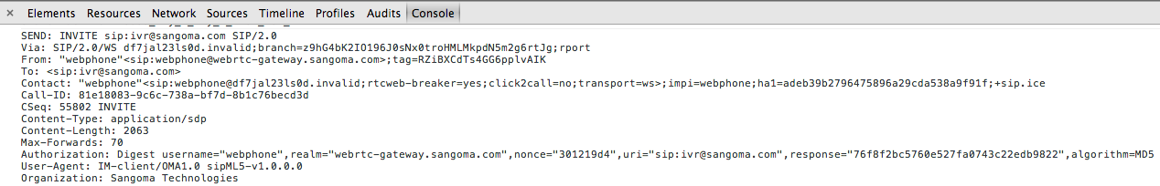
Troubleshooting
The javascript console is your friend

Slide 30
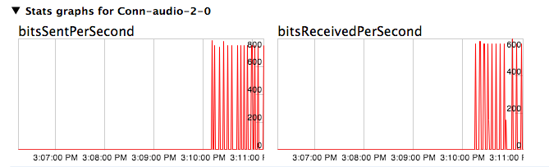
Troubleshooting
Checking out chrome://webrtc-internals

Slide 31
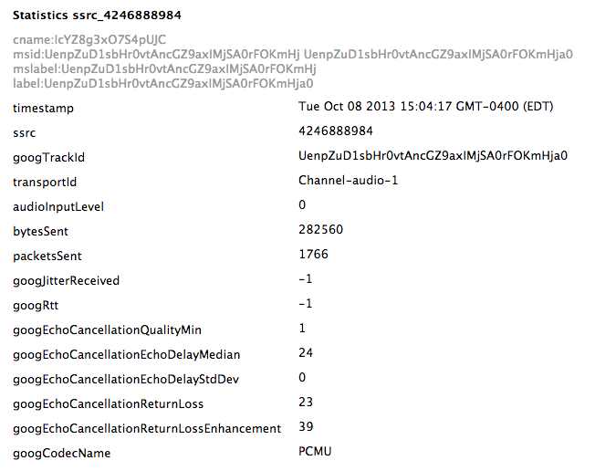
Troubleshooting
Checking out chrome://webrtc-internals

Slide 32
Troubleshooting
Note that Wireshark VoIP calls menu won’t work for calls over websockets
You can however use “Follow TCP stream” and see the entire SIP signaling flow
RTP decoding will not work either (rtcp-mux)

Slide 33
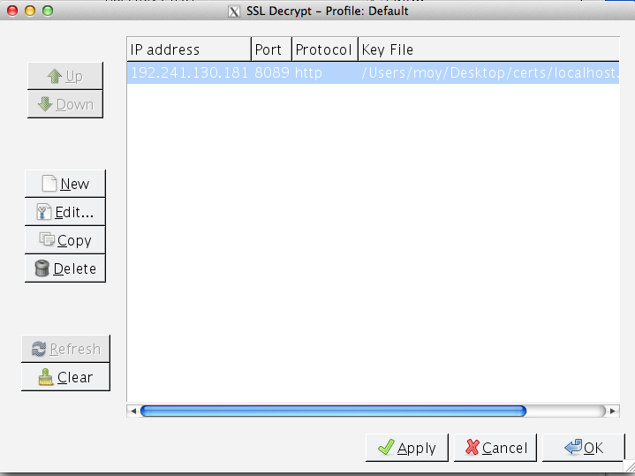
Troubleshooting
TLS decryption can be achieved by installing the private key on Wireshark
  Preferences -> Protocols -> SSL -> RSA Key List

Slide 34
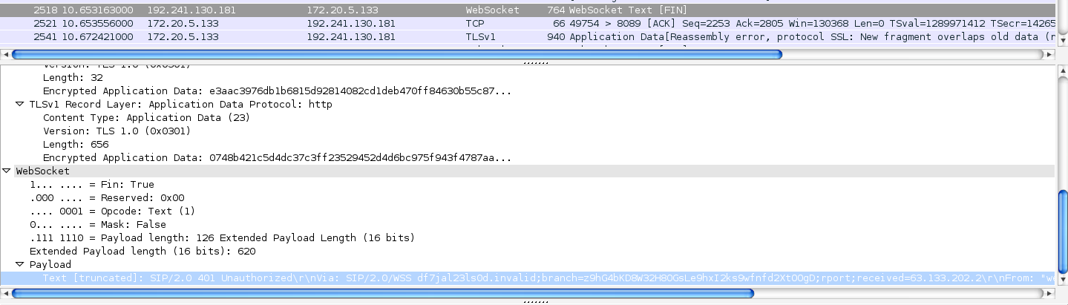
Troubleshooting
Wireshark decrypted secure WebSocket payload

Slide 35
Future
Trickle Ice
Use of other codecs (ie Opus, iSAC)
Video (VP8)
Use libwebsockets in res_http_websocket?

Slide 36
Conclusion
Asterisk + WebRTC gateway is easy to setup!
Know your debugging tools
Understand the protocols involved
Have fun and hack away!

Slide 37
QUESTIONS

Slide 38

Contact Us
Sangoma Technologies
  100 Renfrew Drive, Suite 100
  Markham, Ontario L3R 9R6
  Canada
Website
http://www.sangoma.com/
Telephone
  +1 905 474 1990 x2 (for Sales)
Email
sales@sangoma.com

Slide 39
THANK YOU

